Slide 1
A Real-time Web Server Access Logs Monitoring And Analyzing System
By –
Prashant Pardeshi
Aniket Chandak

Slide 2

Introduction
Need for the system ?
What we built ?

Slide 3

Dataset Used
NASA HTTP Access Log - http://ita.ee.lbl.gov/html/contrib/NASA-HTTP.html
Log Format –
Host
Timestamp
Request
Response Code
Content Size

Slide 4
What we planned to find ?
Following statistics in real-time -
Count of all response codes.
Count of all client error responses (4xx).
Count of all server error responses (5xx).
Top 10 requested resources.
Top 10 requested resources with the error responses.
Top 10 frequent IP addresses.

Slide 5
How it works?
Read
Analyze
Visualize

Slide 6
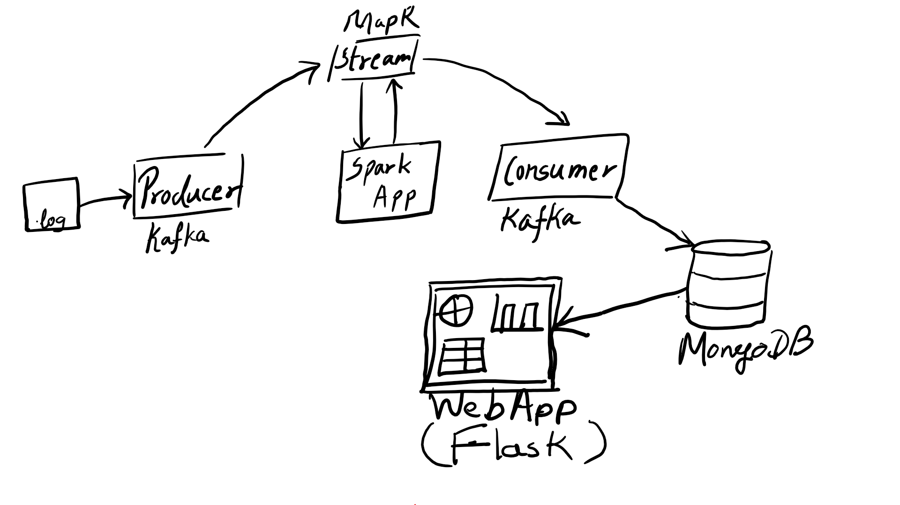
Architecture

Slide 7

Demo

Slide 8
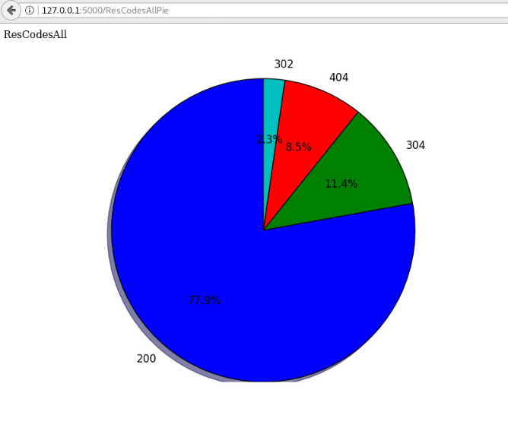
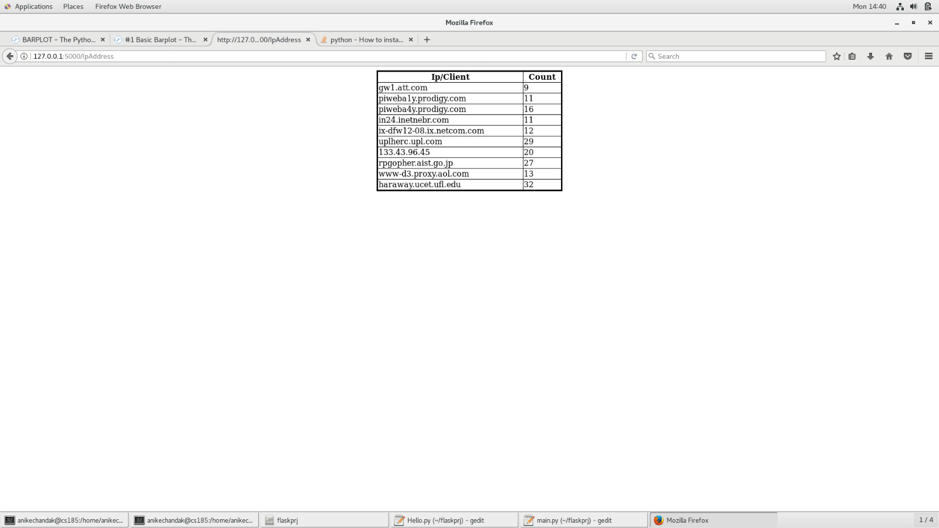
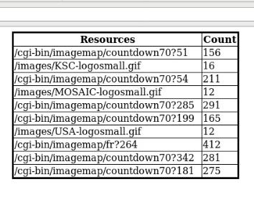
Results

